Slide 1
PebblePad
Getting started with
(your e-portfolio platform)

Slide 2
This presentation shows you everything you need to do prior to a PebblePad training session with the Educational Technology team:
The Educational Technology team
Accessing PebblePad
Changing your password & profile image
Logging out
PebblePocket
Support contact details

Slide 3
Educational Technology Team
John Painter-Blase
Student Services Manager
(Educational Technology)
Ewan Hull
Student Services Administrator (Educational Technology)
We’re here to help with your PebblePad technical issues*:
Email us on dohs-EdTech@york.ac.uk
*for academic queries, please contact your programme/module team

Slide 4
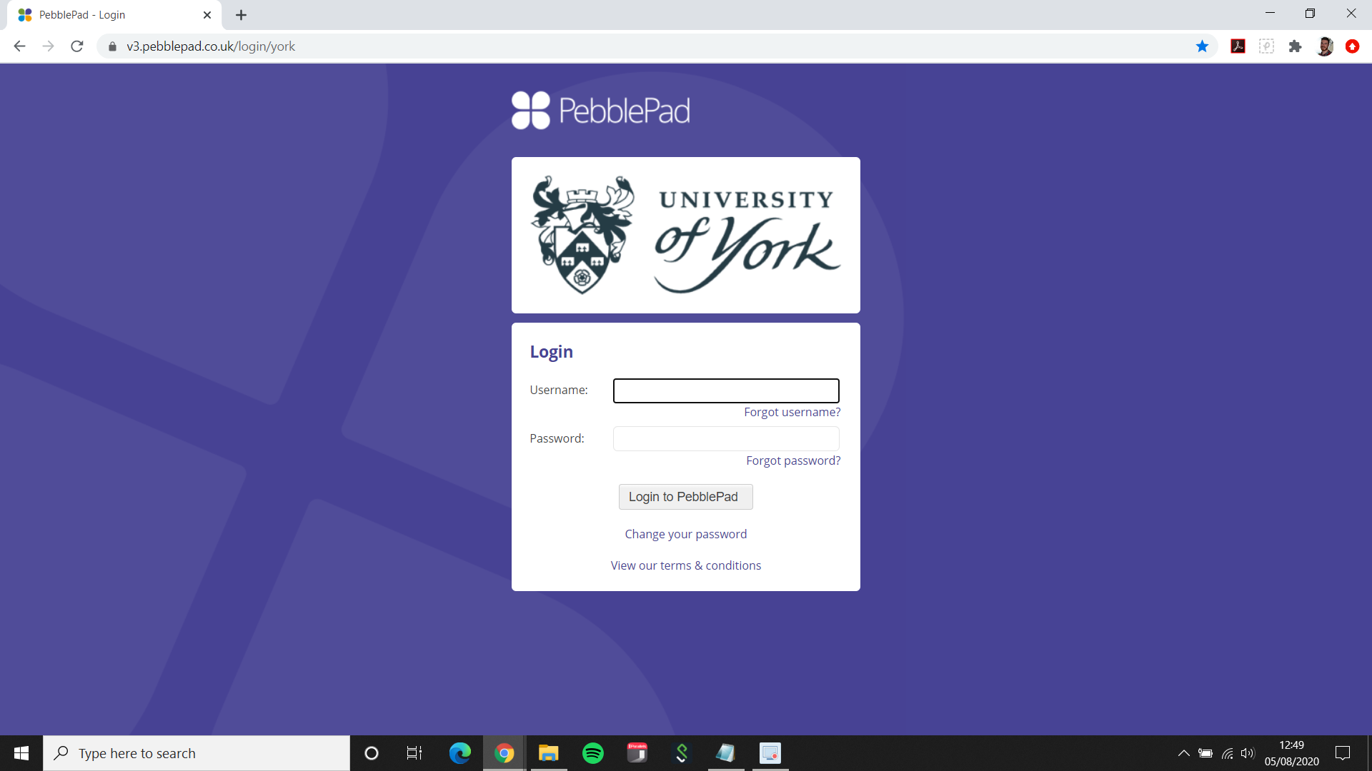
Where to find PebblePad (Option 1)
Directly via URL: http://v3.pebblepad.co.uk/login/york
Save the page to your bookmarks to access PebblePad more easily

Slide 5
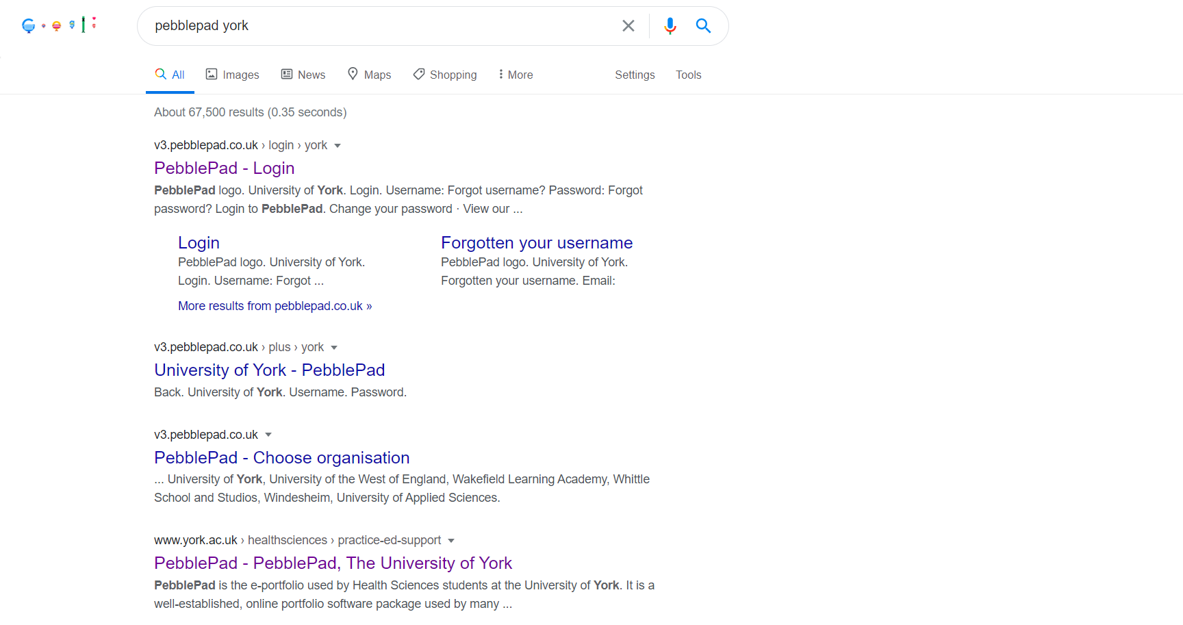
Where to find PebblePad (Option 2)
Search ‘PebblePad York’ in Google:

Slide 6
Where to find PebblePad (Option 3)
1. Navigate to the Health Sciences site and click Practice Support for Supervisors, Assessors and Students:
2. Select the E-Portfolio link:
3. Select the PebblePad login link:

Slide 7
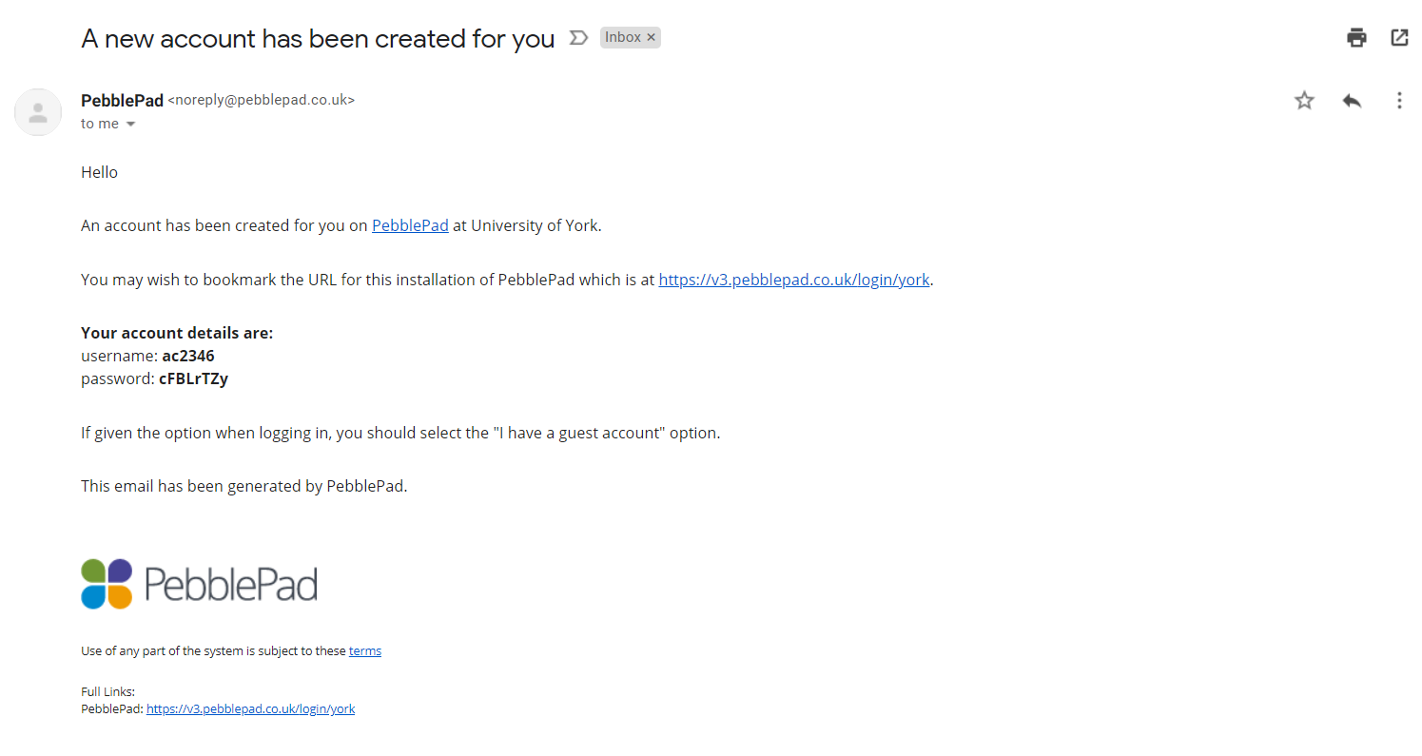
Where to find your PebblePad login details
Your PebblePad login details have been sent to your University email address. Your username will match your University username and your password will be auto-generated:
abc123
cFBLrTZy

Slide 8
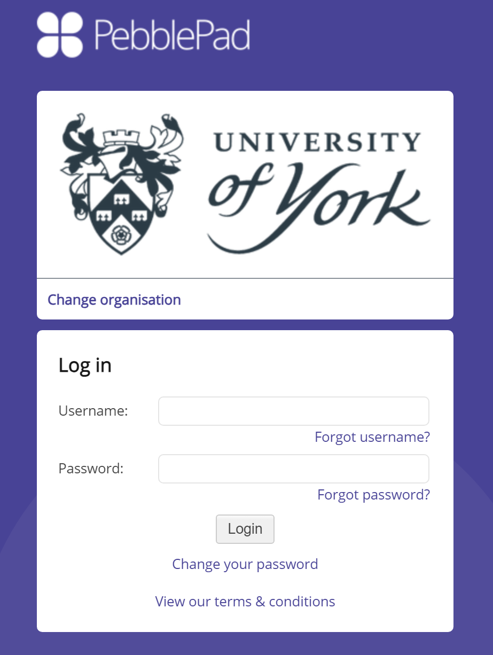
Your password
You will be prompted to choose a new password when you login for the first time
If you forget your password, click the ‘forgot password’ link on the login page to set a new one
Use the ‘change your password’ link to choose a new password at any time

Slide 9
Resources and assets – what’s the difference?
We like to think of the Resources Store as a book shop, and the Asset Store as your bookcase.
Resources is a place that stores all of the things you might wish to own but they belong to the shop. Once you have found the item you want, you can download it. Like you would buy a book from the shop. This will then put the item you have chosen into your Asset store. The Asset store is like your personal bookcase, the things in here belong to you.
Assets – your bookcase
Anything that you upload or create in Pebble+ is called an Asset. Assets contain that you have added or created and that you can go back and edit or delete as required.
Resources – book shop
Resources include PebblePad templates are made available for you to use as part of your programme, and templates and workbooks that you have created for yourself to use.

Slide 10
PebblePad basics: the home screen
*Internet connection required to view video

Slide 11
Changing your profile image
You can change your profile image to any image that you have added to your asset store
To upload images to your asset store:
On a computer, click the burger menu button and ‘Upload a file’
On a mobile device, use the PebblePocket app to upload
To change your profile image:
Click the current profile image on the home screen
Select the new image from the assets

Slide 12
Your workbook
Your programme has its own dedicated workbook(s) for you to download and use:
Programme | Workbook Title
Nursing | UoY MYEPAD Sept 23
Midwifery | UoY eMORA Mid23
Nursing Associate | UOY NAPAD 2023 (Cohort 4)
NMP | Independent Supplementary Prescribing - Sept 2023
ACP | Advanced Clinical Practice Portfolio September 2023

Slide 13
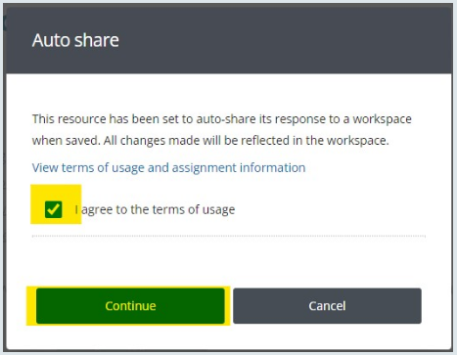
Downloading your workbook
From the PebblePad home screen, click ‘Resources’
If you can’t see the workbook you need, search for its name in the search box
Click the name to open the workbook
Click Save
If you see an auto-share message appear, tick the box to agree and click continue
This shares your workbook with your programme team for assessment

Slide 14
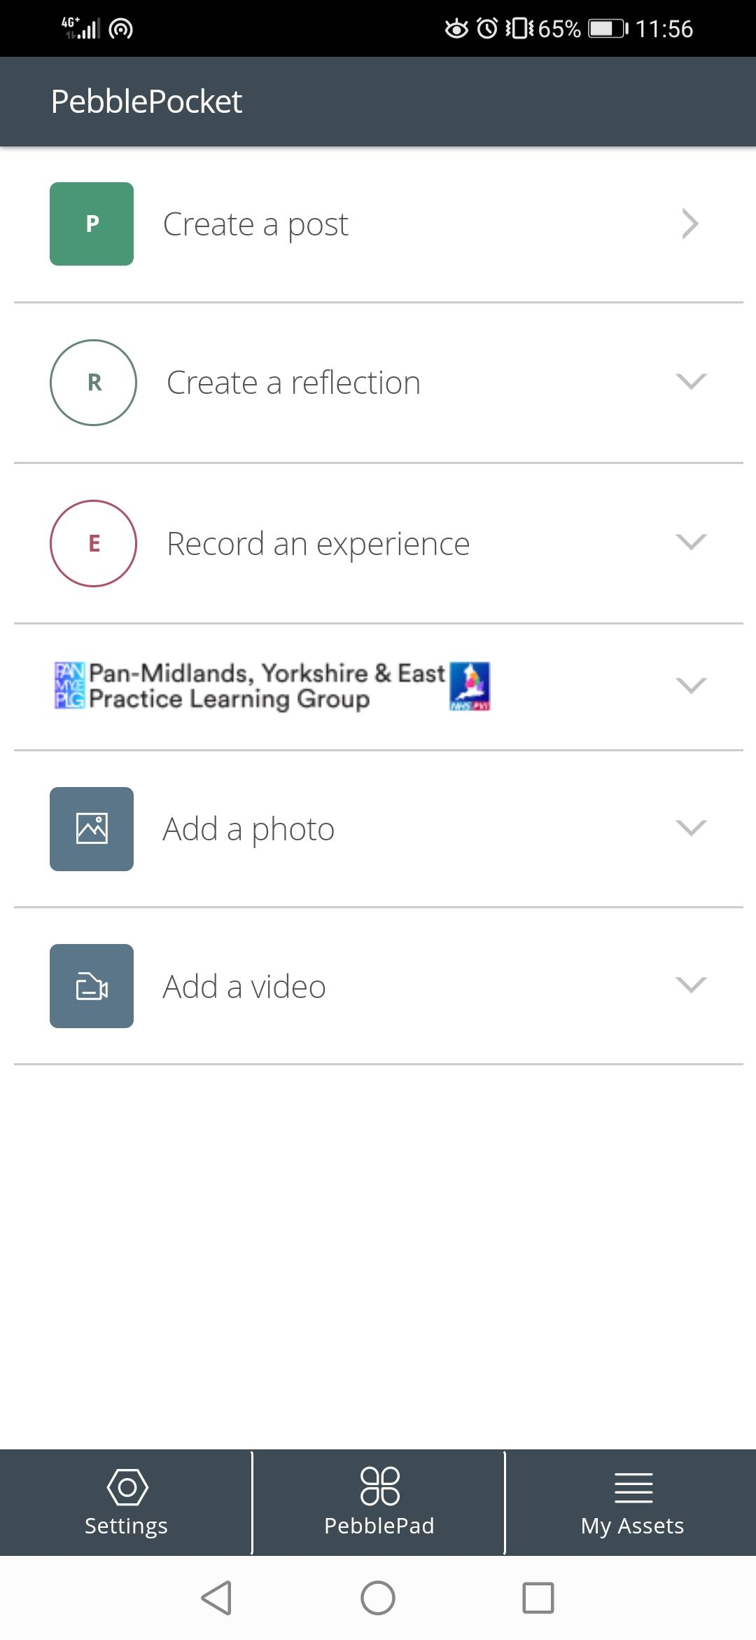
Pebble Pocket
You can use your phone to send documents to your PebblePad via the Pebble Pocket app
You can download the app via your app store and use your PebblePad login details to login
To download Pebble Pocket, click the app store depending on your device:

Slide 15
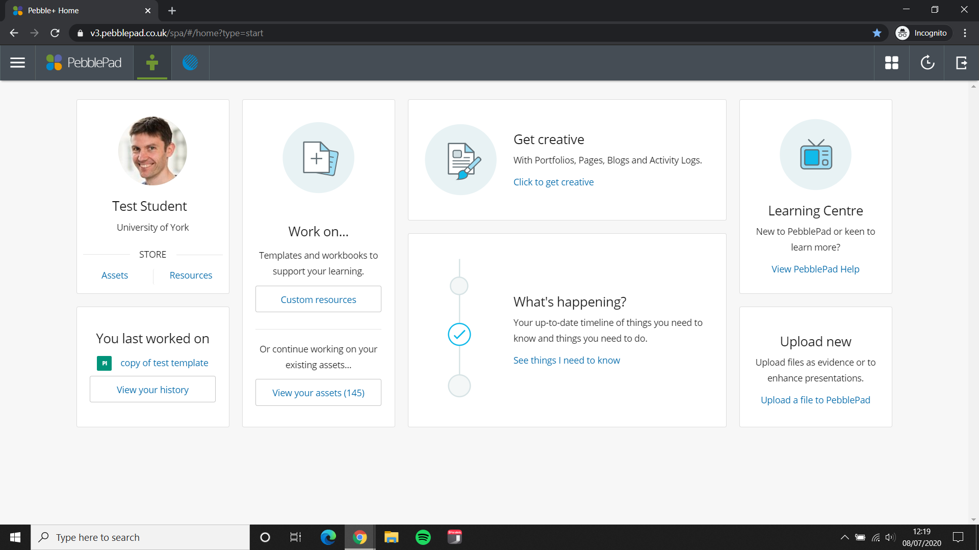
Logging out
Click the Logout button at the top-right of the screen

